Slide 1



RiskForge
A Cybersecurity Vulnerability Management Platform
Team Name: Cyber6 (Team 01)
Module: Enterprise Project - CIS2050-N
Team Members: Daniel Legg et al.
Spring 2025

Slide 2

Problem & Purpose
Problem
Modern IT environments generate large volumes of vulnerability data
Existing tools provide limited context for prioritisation
Enterprise solutions are often complex, costly and difficult to use
Result: vulnerabilities remain unresolved and exploitable
Purpose of the PoC
Demonstrate a centralised vulnerability management platform
That combines:
Asset management
Vulnerability scanning
Risk-based prioritisation
To transform raw scan data into actionable remediation workflows

Slide 3
Research Question & Goal
Research Question
How can we improve vulnerability visibility, prioritisation, and remediation in enterprise networks?
Goal
Provide clear visibility of cyber risk
Improve prioritisation using contextual scoring
Automate scan > analyse > ticket > remediate workflow
Enhance decision making using AI-assisted analysis

Slide 4
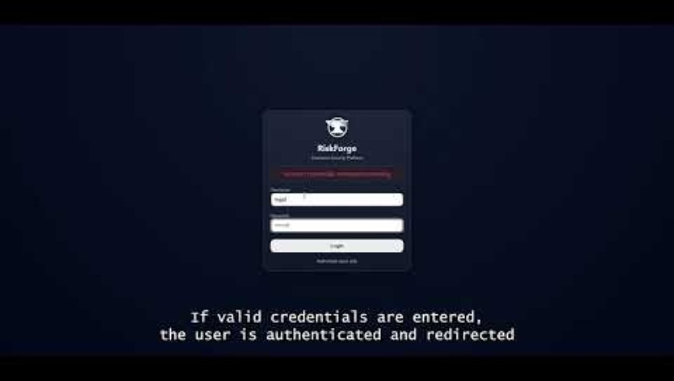
Authentication Demo
Secure login with role-based access control

Slide 5
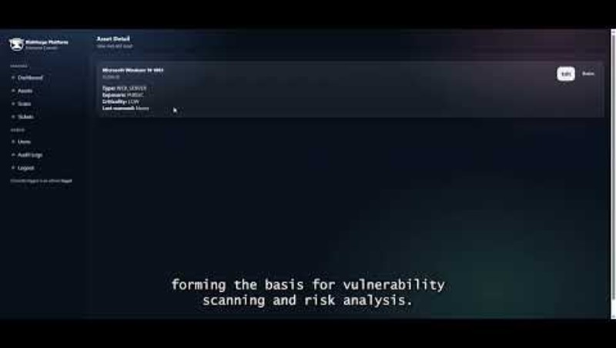
Asset Management Demo
Centralised asset tracking with criticality and exposure context

Slide 6
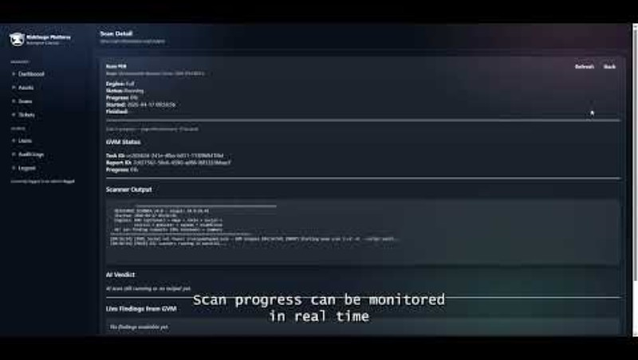
Scanning Demo
Automated scanning using integrated security tools

Slide 7
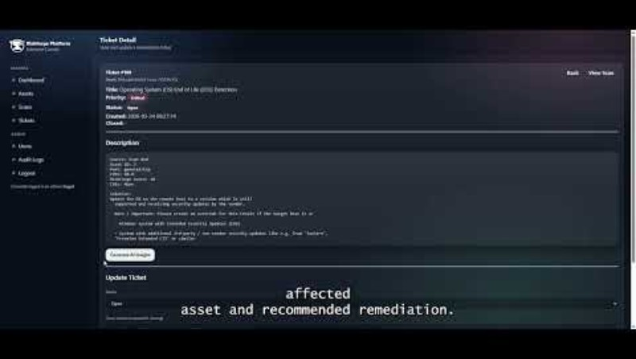
Ticketing & Remediation Demo
Automated ticket generation and lifecycle management for vulnerabilities

Slide 8
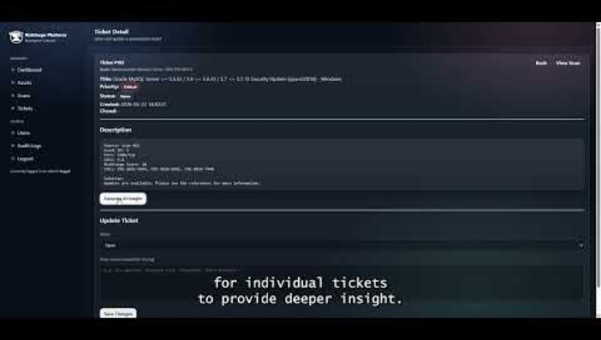
AI-Assisted Analysis Demo
AI-generated insights and remediation guidance for vulnerabilities

Slide 9
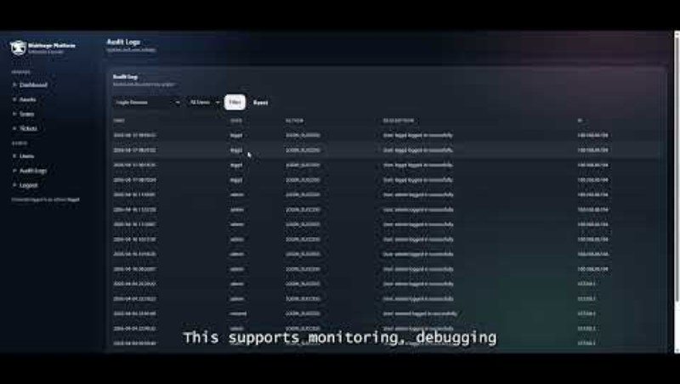
Audit Logging Demo
Tracking user actions and system events for security and accountability

Slide 10
Technology Stack
Backend
Python (Flask)
REST API
Frontend
HTML/CSS
Jinja2
Database
MariaDB
External Integrations
OpenVAS (GVM)
Nmap, Nikto, Nuclei
Groq API
Security
bcrypt
RBAC
HTTPS
Development Tools
GitHub
Trello
VS Code

Slide 11
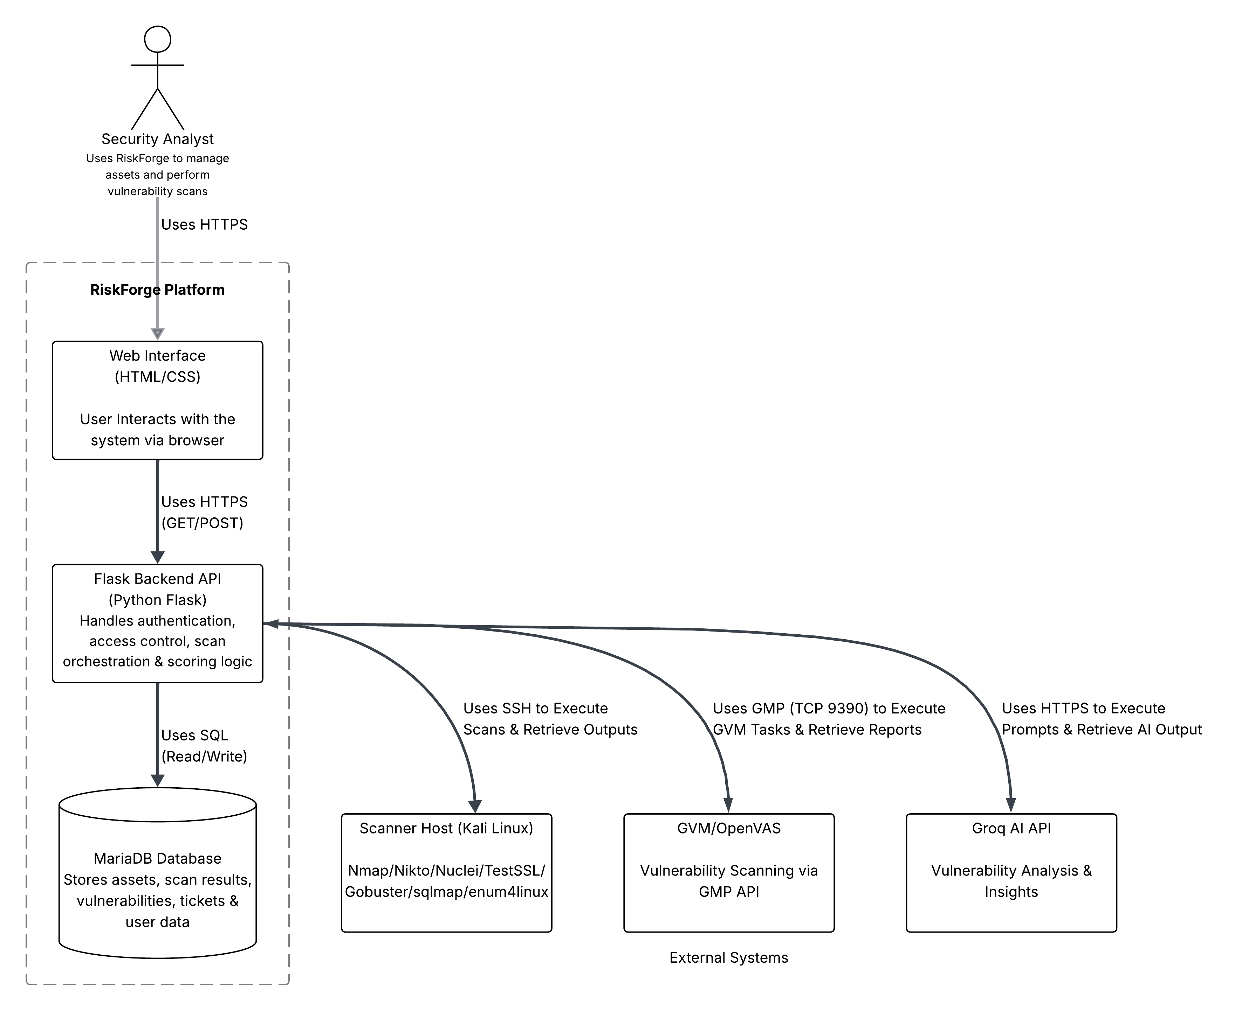
System Architecture
Architecture Overview
Modular client–server architecture
Clear separation of:
Presentation
Application logic
Data storage
External integrations
Core Flow
User interacts via web interface
Backend API handles:
Authentication
Scan orchestration
Risk scoring
Data stored in MariaDB
External Integrations
Scanner Host (Kali Linux) - executes tools
OpenVAS (GVM) - vulnerability scanning
Groq API - AI analysis and insights

Slide 12

Testing and Validation
Security
Password hashing (bcrypt)
CSRF & SQL injection protection
Secure sessions + lockout
Audit logging
Login, scans, ticket fully logged
Verified user attribution
No sensitive data stored
Core system Testing
Authentication & RBAC enforced
Scan workflow validated
Ticket lifecycle verified
Reliability
Edge cases handled
Concurrent actions tested
HTTPS enforced
Automation
Background worker executes scans
Findings Tickets automatically
Auto-remediation (ticket closure)

Slide 13
Team Contributions
Team Member |  | Contribution
Team Member 1 | Database Administrator/Generalist | Database design, schema implementation and compliance documentation
Daniel Legg | Full Stack Developer | Led development of core system functionality, backend service and scanning workflows
Team Member 3 | Software Tester | Testing, bug reporting and quality assurance
Team Member 4 | Backend Developer | Backend development and system design
Team Member 5 | Server Administrator/Generalist | Server infrastructure, deployment and evaluation
Team Member 6 | Flexible Support | Limited Contribution

Slide 14
Compliance
Organisations are faced with many challenges, in the current changing climate, associated with security, legislation and industry disruption. Compliance with legislation and certified governance protocols, Risk Forge can ensure a high level of security and service to clients. This will be enforced by creating internal procedures that help align the solution with compliance and regularly auditing.
Risk Forge will comply with many legislations and compliance boards, but a few will be mentioned below.
BSC code of conduct
GDPR
ICO
Cyber governance code of practise
ISO standard for security management
By complying with the above, Risk Forge will also have a securer relationship with clients. Ethically, Risk Forge should have clear communication with clients and be completely transparent with the services.

Slide 15
Future Work
As part of the further development of the RiskForge platform, the team has identified several priority areas. First, they plan to comprehensively strengthen security, including implementing protection against CSRF attacks and generally hardening the system to protect against web threats.
Secondly, the team will continue to refine the risk assessment model to make vulnerability prioritization even more accurate and tailored to specific business contexts.
Finally, an important step will be the expansion of AI's analytical capabilities and the development of a deep reporting module, which will automate the creation of detailed reports for audit and management.
To ensure the platform's stable operation, redundancy mechanisms are planned. This involves duplicating critical system nodes and setting up automatic data backup. These measures will eliminate a single point of failure and ensure the system remains accessible even in the event of a technical failure on the primary server.

Slide 16
Conclusion
To conclude our project, RiskForge has proven to be a remarkable construct of simplistic design with an enormous range of functionality. It has been designed for the user to be able to easily understand their way around the program. Our team is satisfied with the project management and job role allocation skills that have been set up and the communication presented by all team members. We are pleased with the application created by our ability and all documented testing proves our program has potential to be implemented out to an industry standard. The team has proven that a problem in the service industry was identified and resolved via creating a solution and in this case the solution being RiskForge. This application was a skill building experience for all team members. We are happy to introduce a simplistic web-based application that can be used for critical automated security like tasks.

Slide 17
Resources
Project Resources
GitHub Repository https://github.com/leggd/RiskForge
Key Technologies
Greenbone/OpenVAS Documentation
https://greenbone.github.io/docs/latest/
Nmap Documentation
https://nmap.org/book/man.html
Groq API Documentation
https://console.groq.com/docs/overview
Flask Documentation
https://flask.palletsprojects.com/en/stable/
Supporting Platforms
GitHub (Version Control)
https://github.com/
Trello (Project Management)
https://github.com/
Microsoft Teams (Collaboration)
https://teams.microsoft.com/v2/
Microsoft OneDrive
https://www.microsoft.com/en-gb/microsoft-365/onedrive/online-cloud-storage

